Slide 1
ACHCH HRSA 2020-2022 Services Area Competition (SAC) Overview & Review
ACHCH Director Lucy Kasdin
ACHCH Commission Meeting
August 9, 2019

Slide 2
HRSA Services Area Competition
Competitive SAC proposal submitted every 3 yr Grant Period
Grant Period: 1/1/2020 – 12/31/2022
Base Federal Grant Award/Yr: $3,983,982
HRSA SAC Submission Includes:
Health Center Operations (program specific info)
Staffing: (Federally-supported vs Non-Federal FTEs)
Budget: Grant Budget (federal) and Overall Health Center (non federal)
Comprehensive Project Narrative
Performance Measures and Patient Projections
HCH Commission approval on Friday August 9. Will submit to HRSA after approval. Due August 14.

Slide 3
ACHCH Health Center
Operational Chart
SAC 2020-2022
HCH CONSUMER/ COMMUNITY ADVISORY BOARD (HCH CCAB)
HCH COMMISSION
ACHCH Health Center Co-Applicant Board
Colleen Chawla Director, Alameda County Health Care Services Agency
Co-Applicant Agreement
Subrecipient Alameda Health System (AHS)
Board of Trustees
AHS Co-Applicant HCH Health Center Governing Board
ACHCH directly-provided Services
Federal Grant-funded Contracted Care
Non-Federal funded Contracted Care
Co-Applicant
Agreement
ACHCH HEALTH CENTER PROGRAM DIRECTOR
Lucy Kasdin, LCSW
ACHCH MEDICAL DIRECTOR
Jeffrey Seal MD
ACHCH PRIMARY CARE HOMES
ACHCH
STREET HEALTH SERVICES
ACHCH
SHELTER HEALTH SERVICES
ACHCH SPECIALTY CARE SERVICES
ACHCH CONTRACTS &
ADMINISTRATION
Alameda Health Systems Primary Care Clinics:
Subrecipient provided primary care homes with comprehensive care services:
Highland Wellness
Same Day Clinic
Eastmont Wellness
Hayward Wellness
Newark Wellness
Same Day Clinic
65.31. FTE
ACHCH StreetHealth Team:
Directly provided portable street health care:
Psychiatrist
Nurse Manager
Social Worker
Pharmacist
2 CHW
W.Oakland
12 Street Sites
7 FTE
Lifelong Street Health Downtown:
Contracted portable street health care
Downtown Oakland
8 Street Sites
4FTE
ACHCH SHELTER HEALTH TEAM:
Directly-provided portable health care services:
Behavioral Health Supervisor
Behaviorist
Nurse Practitioner
Social Worker
Social Worker
CHW
8 FTE
ACHCH/AHS MOBILE HEALTH SERVICES:
Subrecipient AHS -staffed Portable Mobile Health Care Services:
Mobile Health Manager
Nurse Practitioner
CHW
Medical Assistant
Medical Support Staff
5 FTE
ACHCH DENTAL CARE:
Contracted mobile and clinic-based full service dental care:
Onsite Dental (mobile)*
La Clinica Dental (clinic)*
*ACHCH shelter health staff provide embedded dental case management
ACHCH Contracts and Administration Staff
Program Director
Medical Director
Quality Director
Grant Manager
Finance Manager
Contracts Manager
Facilities Manager
Support Staff
10 FTE
Lifelong Street Health E.Oakland:
Contracted portable street health care
East Oakland
10 Street Sites
4.6FTE
ACHCH OPTOMETRY
Contracted optical and ophthalmology care
Fruitvale Optometry
Lifelong TRUST Health Center:
Contracted/Directly-Provided primary care home comprehensive care for chronically homeless and disabled
25.6 FTE
Tiburcio Vasquez Street Health:
Contracted portable street health care
Central Alameda County
8 Street Sites
4.6 FTE
Mobile Clinic-based primary and urgent care at 10 shelter sites in Alameda County
Tri-City Street Health S.County
Contracted portable street health care
South-East Alameda County
10 Street Sites
5.3 FTE
Health Care Services at 11 Shelter locations in Alameda County
Alameda Health Systems Specialty Care Services:
Subrecipient-provided specialty care services at Highland Hospital:
Dental Clinic
11 Additional Specialty Care Services
Total 10,000 patients served in 50,000 visits GY2020
Total 144 FTE
Direct, Grant-funded FTE: 26
8,000 patients served in 38,000 visits GY2020
1,000 patients served in 2,000 visits GY2020
2,000 patients served in 7,000 visits GY2020
950 patients served in 3,000 visits GY2020

Slide 4
Alameda Health System
(Health Center Subrecipient)
HCH COMMISSION
ACHCH Health Center Co-Applicant Board
Subrecipient
Agreement
Colleen Chawla Director, HCSA
Kathleen Clanon HCSA Medical Director
Subrecipient
Agreement
ACHCH PROGRAM DIRECTOR
Lucy Kasdin
ACHCH Project Director
ACHCH MEDICAL DIRECTOR
Jeffrey Seal MD
Physician IV
Dr. Seal clinically supervises A.Bird, J.Bunde, ORKoayen, PNP, RNII
AHS Co-Applicant Board
Alameda Health System Health Center Co-Applicant Board
ACHCH Program Organizational Chart – Staff
SAC 2020-2022
26 FTE
(currently vacant positions shaded)
HCH SHELTER HEALTH SERVICES
Director of Shelter Health Services (VAC)
(Behavioral Health Clinical Supervisor)
HCH STREET HEALTH SERVICES
Ted Aames, PhD
Director of Community Services
HCH CONTRACTS AND ADMINISTRATION
HCPA I
VACANT
VACANT
Registered Nurse II
Aislinn Bird MD
Physician III
StreetHealth
Janice Edwards
Finance Manager
David Modersbach
Grant Manager /Special Projects
HRSA Authorized Official
VACANT
Behavioral Health Clinician I
Jared Bunde
Registered Nurse III
StreetHealth
Oteria Randall-Koayen
Nurse Practitioner
VACANT
CHW
Carolyn Ellison
Facilities Manager
Theresa Ramirez
Director of Quality
HCPA I
Andrea Zeppa
Social Worker III
StreetHealth
Nancy Quintero
Social Worker III
William Quan
Social Worker III
Terri Moore
Contracts Manager
Katheryn Barron
Admin Assistant
VACANT
Psychiatric Nurse Practitioner (PNP)
StreetHealth
Karen Tuttle
Specialist Clerk I
Noemi Joves
Medical Clerk
Seth Gomez, PharmD
Sr. Pharmacist
StreetHealth (supervision by ACBH Charles Raynor PharmD)
Wilma Lozada
CHW
StreetHealth
Elaine Colon
CHW
StreetHealth

Slide 5
HCH Program SAC Budget 2020
ACHCH Direct Services Personnel
Staff Category | Staff Name |  | Total Program | HRSA | COUNTY /MHSA
Admin, Fiscal and Contracts
Prog Director/HCPA II | Lucy Kasdin LCSW |  | 1.0 | 0.5 | 0.5
Medical Director | Jeffrey Seal MD |  | 1.0 |  | 1.0
Deputy Director/HCPA I | Vacant |  | 1.0 | 0.5 | 0.5
HCPA I (Quality & Data) | Theresa Ramirez |  | 1.0 | 0.5 | 0.5
Management Analyst (Grants) | David Modersbach |  | 1.0 | 0.5 | 0.5
Program/Financial Specialist (Finance) | Janice Edwards |  | 1.0 | 0.5 | 0.5
Admin Specialist II (Facilities) | Carolyn Ellison |  | 1.0 | 0.5 | 0.5
Admin Specialist II (Contracts) | Terri Moore |  | 1.0 | 0.5 | 0.5
Admin Assistant | Vacant |  | 1.0 | 0.5 | 0.5
Specialist Clerk I | Karen Tuttle |  | 1.0 | 0.5 | 0.5
CHOW I (Front Desk) | Elaine Colon |  | 1.0 | 0.5 | 0.5
Street Health Services
Director of Community Services | Ted Aames PhD |  | 1.0 |  | 1.0
Physician III | Aislinn Bird MD |  | 1.0 |  | 1.0
Senior Pharmacist | Seth Gomez, PharmD |  | 1.0 | 0.5 | 0.5
Psychiatric Nurse Practitioner | Vacant |  | 1.0 | 0.5 | 0.5
RN III | Jared Bunde RN |  | 1.0 | 0.5 | 0.5
Social Worker | Andrea Zeppa ASW |  | 1.0 | 0.5 | 0.5
CHOW II | Wilma Lozada |  | 1.0 | 0.5 | 0.5
CHOW II | Elaine Colon |  | 1.0 | 0.5 | 0.5
Shelter Health Services
Behavioral Health Clincal Supervisor | Vacant |  | 1.0 | 0.5 | 0.5
Registered Nurse II | Vacant |  | 1.0 | 0.5 | 0.5
Mid Level Practitioner | Oteria Randall NP |  | 1.0 | 0.5 | 0.5
Social Worker III | William Quan |  | 1.0 | 0.5 | 0.5
Social Worker III | Nancy Quintero |  | 1.0 | 0.5 | 0.5
CHW | Vacant |  | 1.0 | 0.5 | 0.5
Medical Clerk | Noemi Joves |  | 1.0 | 0.5 | 0.5
Total Vacant FTE |  |  | 6.0 | 3.0 | 3.0
Total Budget FTE |  |  | 26.0 | 11.5 | 14.5

Slide 6
2019 ACHCH Contractors
Vendor Name | Contract Description | Amount 2019 | Amount 2020 | outcomes
Alameda Health System | Subrecipient agreement for provision of Primary Care, specialty care, case management, behavioral health care, enabling services, drug/alcohol services, and collaborative Mobile Health services. Pass through of federal funds for operation of Mobile Health van; some county HCSA funds to support hiring of AHS HCH Director MD-level position. | 527,733 | $785,176 | 5,500 patients treated in 30,500 visits. Includes $160K towards AHS HCH Project Director (AC3 funds)
La Clinica de la Raza | Contracted clinic-based dental care to provide patients with emergency, restorative and specialty dental services in coordination with health center patient care managers. | 127,363 | $124,536 | 100 Patients complete dental treatment plan
On Site Dental Foundation | Contracted portable/mobile dental care provided for health center patients for one weekly mobile dental unit clinic, providing patients with emergency, restorative and specialty dental services in coordination with health center patient care managers. | 220,000 | $250,000 | 50 weekly full-day sessions providing 1,400 visits/year to 200 health center patients.
Lifelong East Oakland Street Health Team | East OaklandStreet Medicine - Contract to provide direct Street Health nursing and medical services, outreach, and enabling services to unsheltered persons living in encampments and on streets, increasing engagement and access to harm reduction, primary care medical homes, patient stabilization and related services. |  | $350,000 | Target 210 patients engaged in services, outreach to at least 1000 patients annually.
Tri-City South/East County Street Health Team | South County Street medicine : Contract to provide direct street primary care/urgent care clinical medical services, outreach, and enabling services to unsheltered persons living in encampments and on streets, increasing engagement and access to harm reduction, primary care medical homes, patient stabilization and related services. | 200,000 | $350,000 | Target 210 patients engaged in services, outreach to at least 1000 patients annually.
Lifelong Downtown Street Health Team | Downtown Oakland Street Medicine - Contract to provide direct street primary care/urgent care clinical medical services, outreach, and enabling services to unsheltered persons living in encampments and on streets, increasing engagement and access to harm reduction, primary care medical homes, patient stabilization and related services. |  | $350,000 | Target 210 patients engaged in services, outreach to at least 1000 patients annually.
Fruitvale Optical | Contract with centrally-located North County optometry clinic to provide optometry exams and optical services to health center patients in coordination with health center care managers. | 50,000 | $100,000 | Projected goal is 200 patients per year.
Tiburcio Vasquez Central County Street Health | South County Street medicine : Contract to provide direct street primary care/urgent care clinical medical services, outreach, and enabling services to unsheltered persons living in encampments and on streets, increasing engagement and access to harm reduction, primary care medical homes, patient stabilization and related services. | 200,000 | $350,000 | Target 210 patients engaged in services, outreach to at least 1000 patients annually.
LifeLong Medical Care TRUST Clinic | Primary Care Services- ACHCH contracts with Lifelong Medical Care to provide high-value integrated primary care, behavioral health, substance use and enabling services to address physical, mental, and social well-being of indigent, diabled persons experiencing homelessness. Partner organizations collaborate closely to promote overall health and well-being, and to develop or re-establish strong social support networks outside of the public services system. | 1,297,010 | $1,576211 | Projected 1500 unique patients served / year. Note: contract increase to payback for rent & clinical staff cost at TRUST in order to maximize PPS rate.

Slide 7
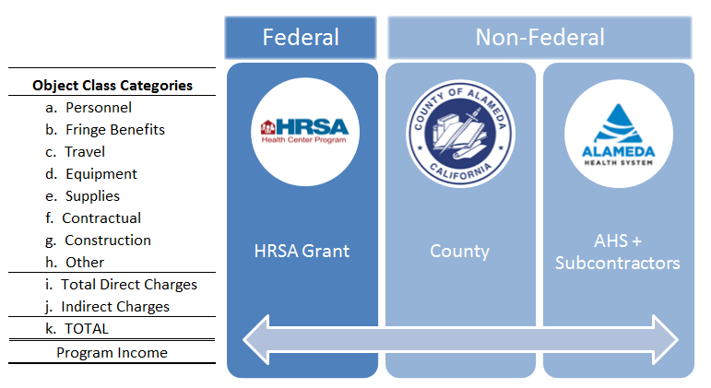
ACHCH Health Center Budget
2020: $22.8M $3.9M $5.4M $13.5M

Slide 8
HCH Program vs. Health Center Budget:
Key Category |  | Program Budget 2020 |  | Health Center Budget 2020
Scope of Budget |  | County Program/Staff & grant contracts |  | County Program + AHS + Contractors
FTE |  | 26 FTE |  | 144 FTE (est)
Total Budget ($) |  | $9,371,723 |  | $22,865,309
- Federal Fund |  | $3,983,982 |  | $3,983,982
- Non Federal Fund |  | $5,387,741 |  | $18,881,327

Slide 9
HCH Program Budget GY2020 detail
Program Budget (Federal Grant)
Key Category | 2019 | 2020 | Key Note
FTE | 20 | 26 | 6 FTE increase
Total ACHCH Program Budget | $7,551,145 | $9,371,723 | 24% increase
- Fed HRSA grant | $3,942,892 | $3,983,392 | 1.0% increase
- Non-Fed Fund (County and MHSA funds) | $3,608,253 | $5,387,741 | 49% increase (MHSA & County funding) in GY2020
- Salary & Benefits | 2,138,358 | 1,259,620 | Reduce grant salaries to pay increased contract costs; offset by increased County commitment to salaries
- Travel | 18,840 | 18,840
- Supplies | 60,400 | 71,100
- Contractual | 1,672,536 | 2,221,324 | New Street Health Contracts
- Others | 221,800 | 172,300
- Indirect Cost | 261,015 | 240,797 | Incl. 1 AA + Admin/Fin Svcs
- Unallocated Fund | - | -
ACHCH is budgeting to maximize entire HRSA salaries by middle 2020; after which County-funding will be made available to cover staff salaries.

Slide 10
HRSA PERFORMANCE MEASURES SAC 2020-2022
Measure |  | 2018 numbers | 2019 Target | 2021 SAC Target | Contrib/Restrict Factors/ Notes
Access to Prenatal Care | Percentage of prenatal care patients who entered treatment during their first trimester | 70% | 70% | 80% | FINHA
Birthweight | Percentage of patients born to health center patients whose birthweight was below normal (less than 2500 grams) | 5% | 6% | 5% | FINHA
Childhood Immunization | Percentage of children with their 3rd birthday during the measurement year or January 1st of the following year who are fully immunized before their 3rd birthday. | 20% | 80% | 75% | AHS Epic reporting connecting to State IZ database in 2020
Cervical Cancer Screening | Percentage of women 21-64 years of age who received one or more tests to screen for cervical cancer | 61% | 65% | 65% | increased Street Health services will lower #'s
Adolescent Weight Assessment and Counseling | Percentage of patients aged 3 until 17 who had evidence of BMI percentile documentation AND who had documentation of counseling for nutrition AND who had documentation of counseling for physical activity during the measurement year | 57% | 95% | 80% | Epic improvement at AHS will improve
Adult Weight Screening and Follow-up | Percentage of patients aged 18 and older who had documentation of a calculated BMI during the most recent visit or within the six months prior to that visit and if the most recent BMI is outside parameters, a follow-up plan is documented | 34% | 70% | 70% | influenced by Street Health numbers, Epic
Tobacco Use Screening and Cessation | Percentage of patients age 18 years and older who were screened for tobacco use at least once during the measurement year or prior year AND who received cessation counseling intervention and/or pharmacotherapy if identified as a tobacco user | 94% | 90% | 95% | increased Street Health services may lower #'s, but critical
Use of appropriate medications for asthma | Percentage of patients 5–64 years of age who were identified as having persistent asthma and were appropriately prescribed medication during the measurement period | 94% | 80% | 95%
Cholesterol Treatment (Lipid Therapy for Coronary Artery Disease (CAD) | Percentage of patients aged 18 years and older with a diagnosis of Coronary Artery Disease (CAD) who were prescribed a lipid-lowering therapy | 99% | 95% | 95%

Slide 11
Ischemic Vascular Disease (IVD): Aspirin or Antithrombotic Therapy | Percentage of patients aged 18 years and older who were discharged alive for acute myocardial infarction (AMI) or coronary artery bypass graft (CABG) or percutaneous transluminal coronary angioplasty (PTCA) in the prior year OR who had a diagnosis of ischemic vascular disease during the measurement year who had documentation of use of aspirin or another antithrombotic | 97% | 90% | 95%
Colorectal Cancer Screening | Percentage of patients aged 50 to 75 who had appropriate screening for colorectal cancer | 57% | 65% | 65% | increased Street Health services will lower #'s
HIV Linkage to Care | Percentage of newly diagnosed HIV patients who had a medical visit for HIV care within 90 days of first-ever HIV diagnosis | 100% | 95% | 100%
Depression Screening and Follow-up | Percentage of patients aged 12 and older screened for clinical depression using an age appropriate standardized tool AND follow-up plan documented | 56% | 90% | 80% | increased Street Health services may lower #'s, but critical
Dental Sealants | Percentage of children, age 6–9 years, at moderate to high risk for caries who received a sealant on a first permanent molar during the reporting period |  | 50% | 90%
Hypertension | Percentage of patients 18 to 85 years of age with diagnosed hypertension (HTN) whose blood pressure (BP) was less than 140/90 at the time of the last reading | 74% | 75% | 80% | increased Street Health services may lower #'s, but critical
Diabetes | Percentage of adult patients 18 to 75 years of age with a diagnosis of Type I or Type II diabetes, whose hemoglobin A1c (HbA1c) was greater than or equal to 9% at the time of the last reading in the measurement year | 36% | 30% | 30% | Focus of cross Health Center Quality activities
Additional: Ensure Access to comprehensive oral health services for homeless persons treated in portable care settings | By 2019 increase access to comprehensive oral health examinations, dental services and supportservices to at least 30% of homeless patients receiving medical services on ACHCH portable medical care (mobile medical clinic and Street Medicine). | 36% | 30% | 30% | How to track access to Dental homes

Slide 12
Financial Viability / Costs
Total Cost Per Patient | ACHCHP is expecting our average cost per patient to be increased for the next 2 years to $1,600. Our program strategy is to perform increasingly costly work with chronically homeless patients with complex comorbidity. | $ 1,839 | $ 1,600 | $ 1,800
Medical Cost Per Medical Visit | Maintaining average medical cost/visit to under $350 during the length of the Project Period | $ 412 | $ 350 | $ 400
Health Center Program Grant Cost Per Patient | Limit the total 330 grant funding per patient to less than $360. | $ 386 | $ 360 | $ 360
Change in Net Assets to Expense Ratio | N/A
Working Capital to Monthly Expense Ratio | N/A
Long-Term Debt to Equity Ratio | N/A
Additional Measure: Provider Productivity | Utilization of licensed providers, including physicians, nurse practitioners, licensed mental health providers, dentists, optometrists, and ophthalmologists. | 1403 | 1800 | 1500
Additional Measure Program Income to Grant | By the end of 2018, the total of HCH program non-federal income over the total of HRSA 330 (h) grant is 3:1 | $ 2.0 | $ 3.0 | $ 2.4 | $ -

Slide 13
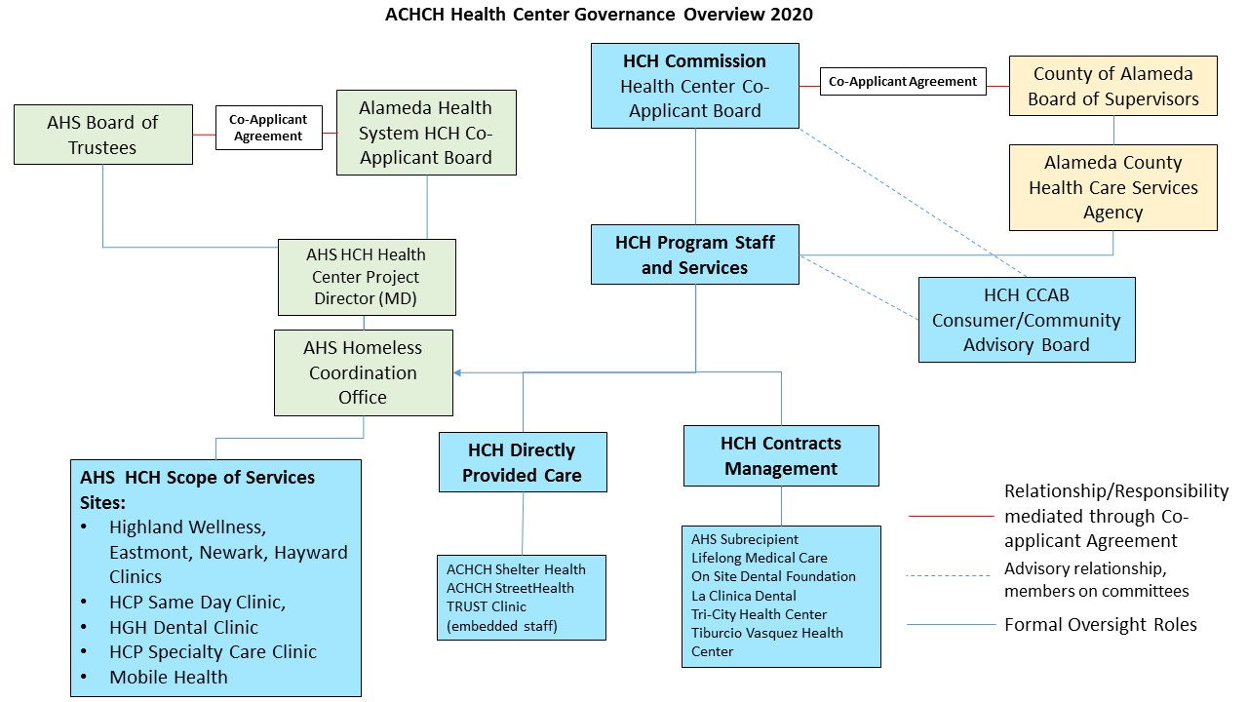
ACHCH Governance Structure

Slide 14
ACHCH HRSA SAC CY 2020-2022 Operational Highlights
Changes in Health Center Structure?
Program Chart and Org Chart Changes
Big Increase in Street Health Services – Crisis of unsheltered homelessness
Expansion of Specialty Care Services – increase in morbidity, aging population
Multidisciplinary Teams (BH, SUD, housing) horizontally integrating key services vs silo’ed care.
Environment Major Changes:
Impact of Housing Crisis and Unsheltered/Encampment Homeless
Role of ACHCH in coordinated countywide response & planning
Uncertainty in Trump Regime
Impact of AC3, PRIME ending – what impacts? What roles foisted on ACHCH?
ACHCH Lead Role in Respite Care Planning & Delivery? Direct Services?
Organizational Capacity
Must work to fill key vacancies, AND secure smooth transition to increased County funding.
Target Patient Numbers:
9,987 homeless patients projected to be served in CY2022
We’re already hitting those numbers.

Slide 15
Questions / Comments

