Slide 1
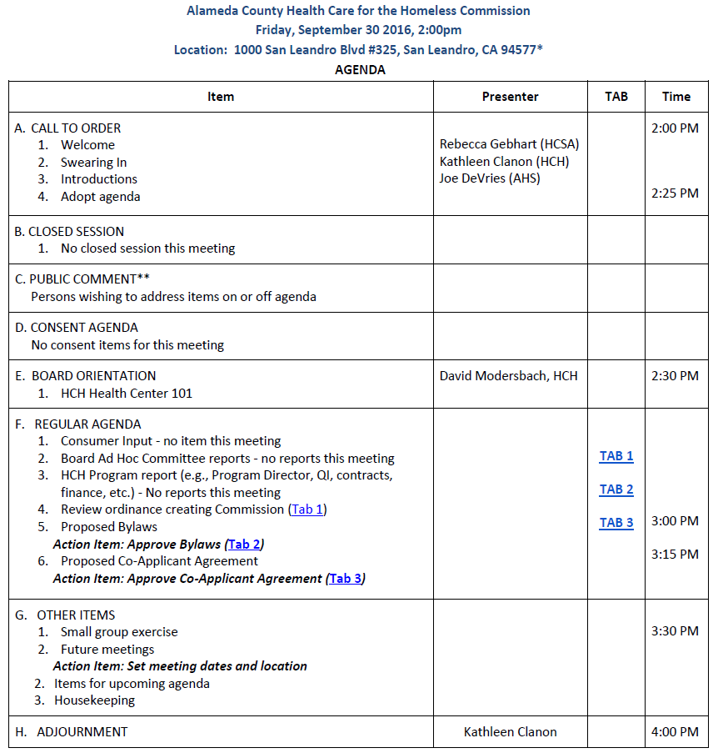
Alameda County Health Care for the Homeless Commission

Slide 2
Alameda County Health Care for the Homeless
Health Care for the Homeless Commission Meeting
September 30, 2016
Homeless Health Center 101

Slide 3
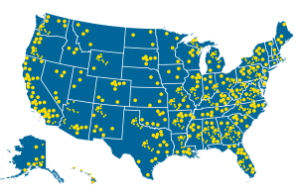
Bureau of Primary Health Care/Health Resources Services Administration Health Center Program
Dates back to 1960’s
1,375 Health Centers
25,000,000 patients served
225 Health Care for the Homeless (330H) health centers
25 Local Health Department-based HCH’s
ACHCHC is unique!
Health Center Programs:
Are located in and serve high need communities
Provide comprehensive primary care and enabling services
Provide services to all according to need
Receive federal grant, FQHC status and other benefits
Meet HRSA performance and accountability requirements
Are governed by community board who represent the population served*

Slide 4
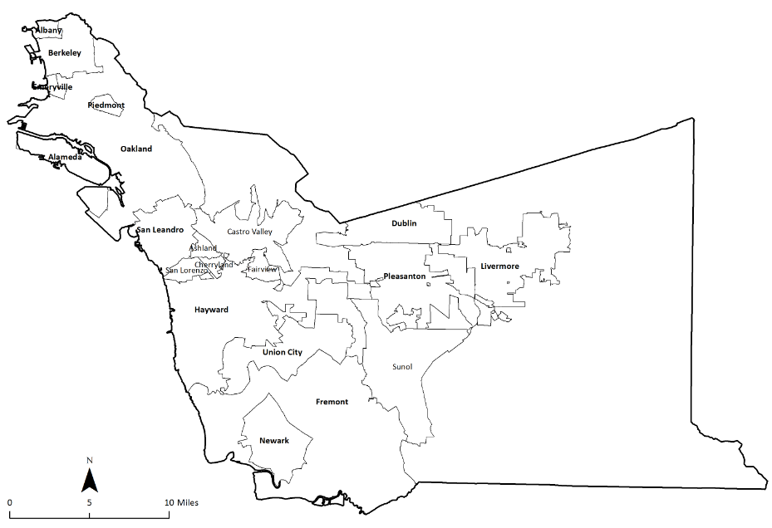
Alameda County
10 FQHC Clinics (Health Centers)
Lifelong Medical Care
La Clinica de la Raza
Native American Health Center
Tri City Health Center
Axis Health Center
West Oakland Health Center
Asian Health Center
Tiburcio Vasquez Health Center
Davis Street Health Center
ACHCH Target Population is persons experiencing homelessness throughout entire Alameda County – estimated 23,000 persons per year

Slide 5
Alameda County Health Care for the Homeless
Mission:
Improve the health of persons in Alameda County who are experiencing homelessness.
Vision
In a socially just society, all persons have access to quality health care and housing. We believe the problems of homelessness and health disparities can be solved.

Slide 6
ACHCH health center services are provided in 4 major ways:
Primary Care Homes for persons experiencing homelessness | Urgent Care Services | Specialty Dental, Optometry, Behavioral Health, Recovery | Enabling Services

Slide 7
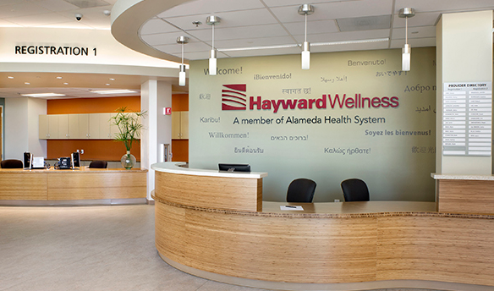
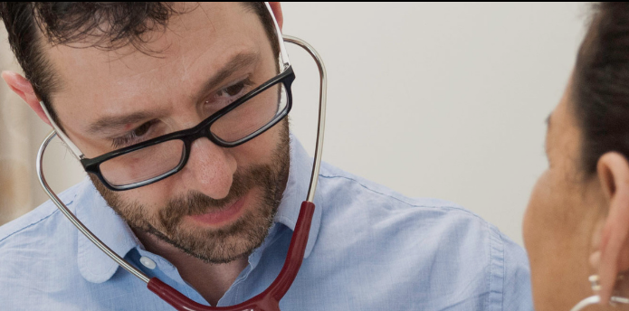
1. Primary Care Medical Homes for persons experiencing homelessness
ACHCH health center includes six clinics providing primary care medical homes for persons experiencing homelessness:
Alameda Health System Ambulatory Care Clinics
Highland Wellness
Eastmont Wellness
Hayward Wellness
Newark Wellness
4900 patients in 2015
ACHCH/Lifelong TRUST Health Center
386-14th Street Oakland
350 persons in 2016
ROOTS Community Health Center
9925 International Blvd Oakland
50 patients in 2016

Slide 8
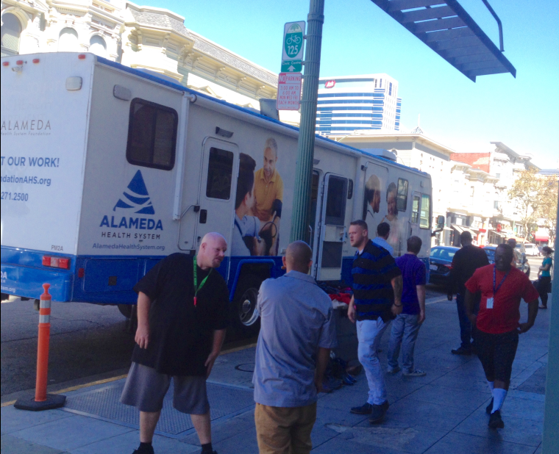
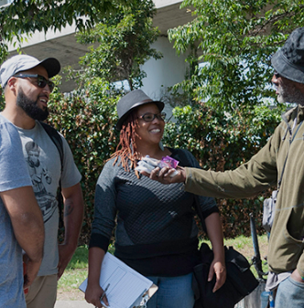
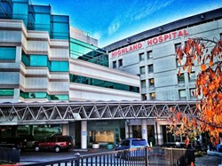
2. ACHCH Urgent Care Services
ACHCH/AHS Mobile Medical Clinics 2 mobile units; 11 sites throughout County | Street Medicine ROOTS North County Street Medicine Tri-City/Abode South County Street Medicine | AHS Same Day Urgent Care Clinic
580 persons served in 2015
1,200 persons served in 2015
Est 350 persons served 2016

Slide 9
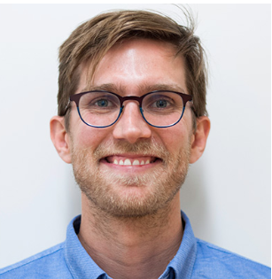
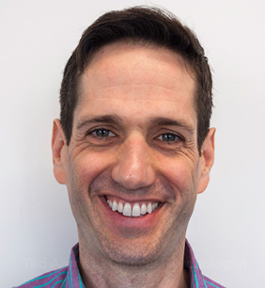
3. ACHCH Specialty Care Services
Restorative Dental Care
Mobile Dental Unit
La Clinica Dental
350 Patients in 2015
Behavioral Health Care Services
Psychiatry, Psychology, LCSW services
Community-based contracted Substance Use treatment services 1900 Patients in 2015
Buprenorphine and MAT services TRUST/AHS in 2016

Slide 10
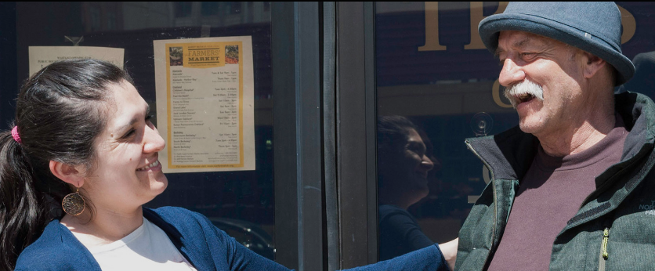
4. HCH Enabling Services: Case Management, Outreach and Care Coordination
Case Management
Outreach, Engagement, Enrollment
Home Stretch
Whole Person Care Pilot

Slide 11
2015
9,301 patients served in 37,000 encounters
$14M budget
$3.8M HRSA Grant
18 FTE Alameda County staff, 11 Contractor FTE, 79 AHS FTE
9 CBO contracts for patient care services

Slide 12
Programmatic Chart -- Alameda County Health Care for the Homeless (2017-2019 SAC)
Alameda County Board of Supervisors
Co-Applicant Agreement
HCH Commission (ACHCH Co-Applicant Board)
Co-Applicant Agreement
Alameda Health System Board of Trustees
Key:
Scope of Project, Grant-funded
Health Care Services Agency
Scope of Project,
MHSA Funded
HCSA Medical Director
Behavioral Health Care Services Department
Indigent Health and Administration
Scope of Project,
AHS Funded
Health Care for the Homeless
AHS Homeless Services Outside Scope of Project
HCH Contracted Care:
HCH Direct Services:
Subrecipient Partner AHS Ambulatory Care
Street Medicine
Mobile Services & Nursing Care
AHS Homeless Coordination Office
Substance Use
AHS Care Transitions Team
Outreach/Enrollment
Mobile Care (Clinical)
Fairmont Skilled Nursing
Oral Health
AHS Emergency Department
Behavioral Health
Primary Care (4 Clinics)
AHS San Leandro Hospital
TRUST Health Center
AHS Respite Care
Urgent Care (SDC)
AHS Alameda Hospital
Home Stretch
AHS HOPE Center
Homeless Substance Abuse Services (MAT)
AHS JGP Psychiatric Pavilion
AHS Social Work Dept
Highland Advocates (Enabling Services)
AHS Highland Hospital

Slide 13
19 HRSA Health Center Requirements
Periodic Needs Assessment (every 3 years, updated annually)
Required Health Center Services (Primary Care, Enabling Services, substance use)
Core Staffing Requirements
Accessible Hours of Operation/Locations
After Hours Coverage
Hospital Admitting Privileges/Continuum of Care
Sliding Fee Discounts
Quality Improvement / Assurance Plan
Key Management Staff
Oversight of Contracts/Subrecipient
Collaborative Relationships
Financial Management / Control Policies
Billing and Collections
Budget
Program Data Reporting System
Scope of Project

Slide 14
HRSA Health Center Requirements
Governance
ACHCH is a Public Entity health center.
It is governed by a Co-Applicant Board (the HCH Commission) who shares governing authority with
County of Alameda (BOS) and
Alameda Health System (BOT)
mediated through the
Co-Applicant Agreement
17. Board Authority
Monthly Meetings
Approve grant & budget
Select/Dismiss Director
Select/Approve services/hours
Measure & Evaluate program goals
Approve operational policies
18. Board Composition
At least 9 persons including consumers, representing community served.
Consumer Advisory Board
19. Conflict of Interest

Slide 15
HCH Commission/HCH Program Calendar 2016-2020
2016
9/30 First HCH Commission Meeting
HRSA Approval of HCH Commission Structure
Monthly HCH Commission Meetings
October: Approve ACHCH Quality Plan
Orientation Topics at every meeting
2017:
Review of 2016 UDS report
Approval of Changes in Scope
6/2017 National HCH Conference DC
Approval of 2018 Budget (BPR)
2018
HCH Program Needs Assessment
8/2018 HRSA Operational Site Visit
Approve 2019 Budget
2019
Approve 2020-2022 Services Area Competition

Slide 16
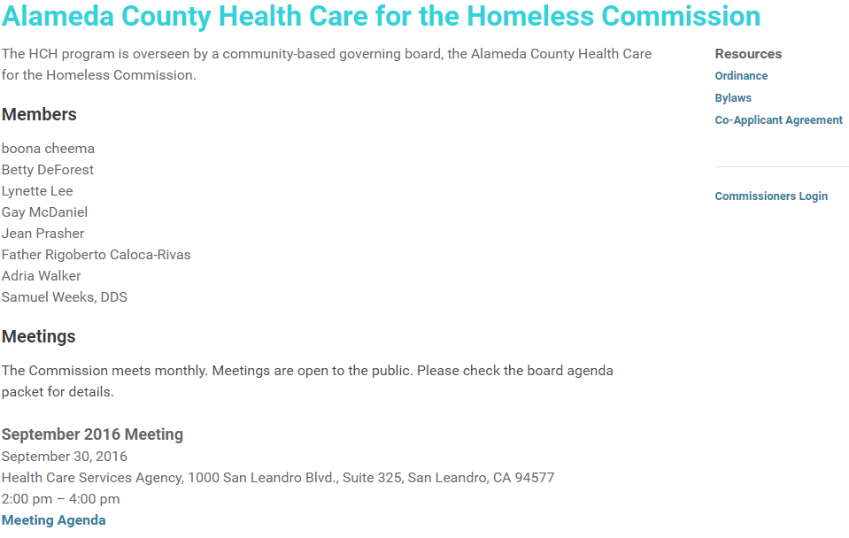
www.achch.org

